Slide 1


Slide 2



Senior Computer Science student at FCI ,Damanhour University.
Graduate of the ITI Introduction to Web Development program (60 hours).
enrolled in the ITI 120-hour Angular & Django Track.
Trainee in the Digital Egypt Pioneers Initiative - Front-End React Track, with Skill Dynamix intrast
HR Member at GDSC Damanhour - Season 2.
Former Leader of Google Developer Student Clubs (GDSC) Damanhour University – season3
GDG-ON-Campus Egyptian mentor (MENA Region)
Front-End Instructor at GDG On Campus Damanhour University – season 4
Maison Essam Abo ElMhasen
https://www.linkedin.com/in/mison-essam
misonsssm@gmail.com

Slide 3

Welcome to
Front-End Track - Session 2
CSS - Session 1
4/3/2025

Slide 4
some guidelines to make the most out of the session.
4/3/2025

Slide 5
Cascading Style Sheet - CSS
Table of Contents :
Introduction
What-why
CSS with
html
CSS
selectors
Background color– image
Dimensions - spacing - border
box model box-sizing
Display
Position
Z-index
Text format and spacing
CSS
fonts

Slide 6
what is CSS?!
CSS stands for Cascading Style Sheets.
CSS is an extension to basic HTML that allows you to style your web pages.
It’s a styling language used to control the visual appearance of web pages.
How CSS Works with HTML
HTML Structure: You create an HTML document with elements like headings, paragraphs, images, and links.
CSS Styling: You create a CSS file or embed styles directly in the HTML (though this is generally discouraged).
Linking CSS: In the HTML document, you link the CSS file using the <link> tag in the <head> section.
Browser Rendering: The browser reads the HTML file and constructs the Document Object Model (DOM), representing the structure of the page. Then, it reads the CSS file and applies the styles to the corresponding elements in the DOM. Finally, the browser renders the page based on the styled DOM.

Slide 7
why css?
In general, CSS is considered a design language and not a programming language. It is used in designing web pages that are executed using HTML.
An example of a style change would be to make words bold.
In standard HTML you would use the <b> tag like so: <b>make me bold</b>
This works fine and there is nothing wrong with it.
except that now if you wanted to say change all your text that you initially made bold to underline.
you would have to go to every spot in the page and change the tag
And it's not efficient and takes great effort and time .
So we use CSS.

Slide 8
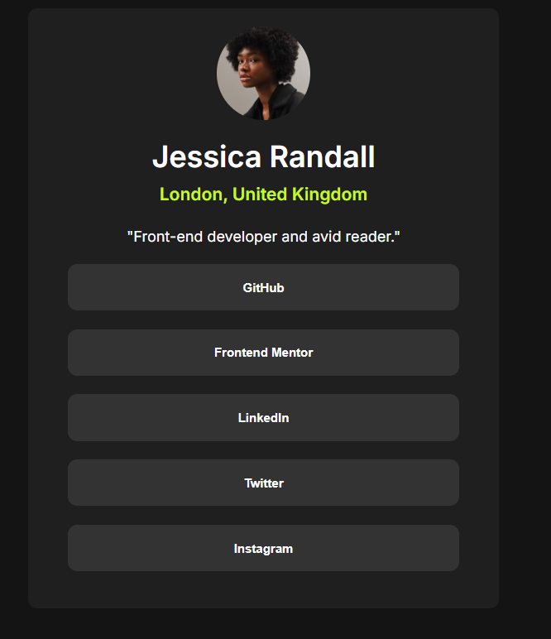
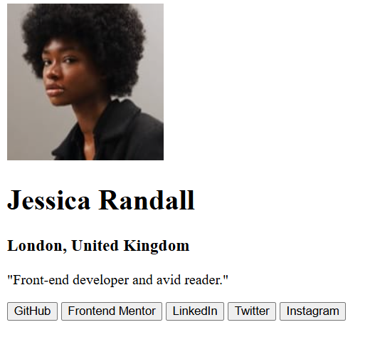
without css vs with css

Slide 9
CSS Attributes Selectors
Attribute Selector description
[target] Selects all elements with a target attribute
[target="_blank"] Selects all elements with target="_blank"
[title~="flower"] Selects all elements with a title attribute that contains a "flower"
[lang|="en"] Selects all elements with a lang attribute value is “en” or “en- “
a[href^="https"] Selects all <a> elements with a href attribute value starting with "https"
a[href$=".pdf"] Selects all <a> elements with a href attribute value ending with ".pdf"
a[href*="w3schools"] Selects all <a> elements with a href attribute value containing the substring "w3schools"

Slide 10

Welcome to
CSS Attributes Selectors Activity
https://www.w3schools.com/css/css_attribute_selectors.asp
4/3/2025

Slide 11
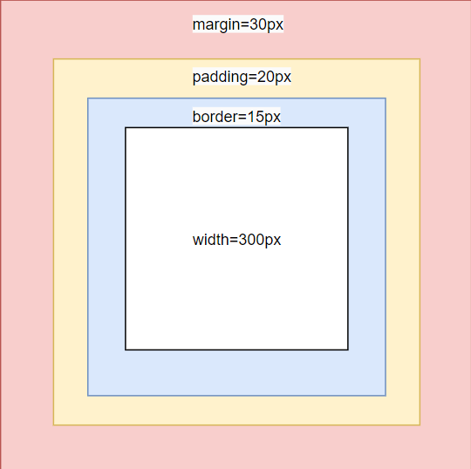
BOX SIZING - CSS
content-box
The actual width =
300(width)+15(border)+20(padding)=335
border-box
The actual width = 300
Because 🡪 padding and border are included in the width

Slide 12
Welcome to
CSS Display
4/3/2025

Slide 13
Display: block
Starts on a new line
Takes up the whole width
Respects padding and margin
Respects width and height
EX: <div> , <p> , <h1> إلى <h6>
<section>, <article>, <header>, <footer>

Slide 14
Display: inline
Don’t add line
Allow elements before and after
Don’t respect width and height
Respect padding, margin (left-right only)
EX: <a> , <span> , <img>

Slide 15
Display: inline-block
Don’t add line
Allow elements before and after
Respects padding and margin
Respecs width and height

Slide 16
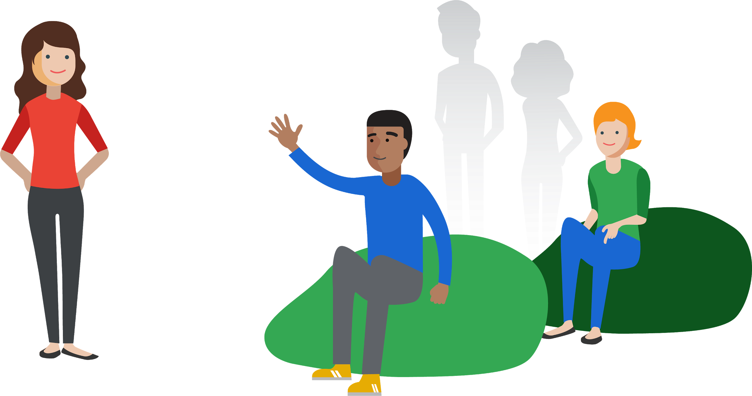
Thank you.
15 minutes Break

Slide 17
Welcome to
CSS Position
4/3/2025

Slide 18
CSS Position
sticky
Static
default value for all elements.
placed the element according to HTML order.
Don’t Respects top, left, right or bottom.
Fixed
stays in place even when scrolled
its location is determined relative to the browser window (viewport).
It is not affected by other content on the page.
Sticky
Combines relative and fixed. It is in relative mode at first, but on hover it changes to fixed and stays stuck to the selected location.

Slide 19
CSS Position
sticky
4. Relative
Makes the element moveable relative to its original position
It does not affect other elements, as the element remains in its original position even if it is moved.
5.Absolute
The element is removed from the normal flow of the page.
it does not affect other elements.
Its position is determined relative to the nearest parent element that has
position: relative;
If there is no parent element in this mode, it will be located relative to <html>.

Slide 20

Welcome to
CSS Position Activity
https://www.w3schools.com/css/css_positioning.asp
4/3/2025

Slide 21
CSS UNITS
px (Pixels) : Unit of measurement to see a wide range accurately. (static)
(Responsive)
% (Percentage) :Depends on the parent element
em : depends on the font size of the current item
rem (Root em): Same as em but depends on the font-size of the root (html). =16px
vw (Viewport Width): Depends on the window width, where 1vw = 1% of the screen width.
vh (Viewport Height): Depends on the window height, where 1vh = 1% of the screen height.

Slide 22

Welcome to
First quiz
https://forms.gle/65vNDoPx2mweiC5NA
4/3/2025

Slide 23
Welcome to
Practice Time
https://www.frontendmentor.io/challenges/social-links-profile-UG32l9m6dQ
4/3/2025

Slide 24
Welcome to
Task Time
https://www.frontendmentor.io/challenges/recipe-page-KiTsR8QQKm
4/3/2025

Slide 25
